Slide 1



Team #2
Solar Car Project
Conceptual Design Review

Slide 2
Team Member
Mechanical Engineers
Electrical Engineers
Keith Dalick
Emiliano Pantner
Adrian Cires
Shishir Rajbhandari
James Barge
Zachary Prisland

Slide 3
Body

Slide 4
Estimated Weight of Vehicle
Driver |  | 176 lbs
Batteries (30) |  | 106 lbs
Battery Management System |  | 7 lbs
Motor |  | 30 lbs
Motor Controller |  | 23 lbs
Solar Array and Components |  | 26 lbs
Suspension |  | 20 lbs
Wheels |  | 7 lbs
Steering Components |  | 24 lbs
Carbon Fiber Body |  | 97 lbs
 | Total Weight | 517 lbs

Slide 5
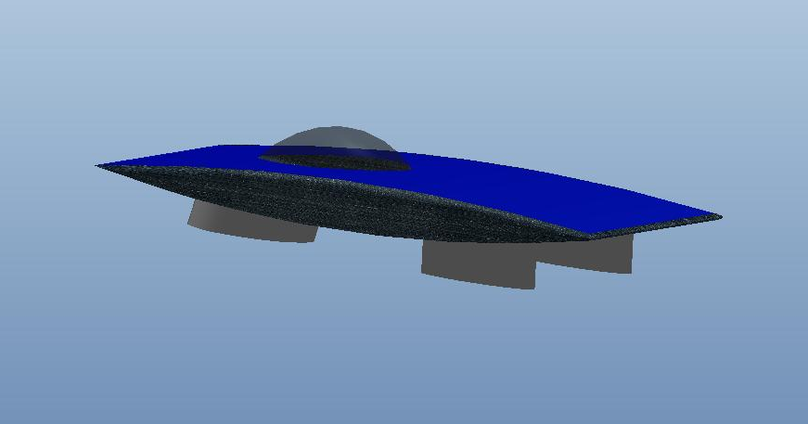
Body Design
Shape
  Overall shape will remain the same
Ride Height
  8 inches from body pan

Slide 6
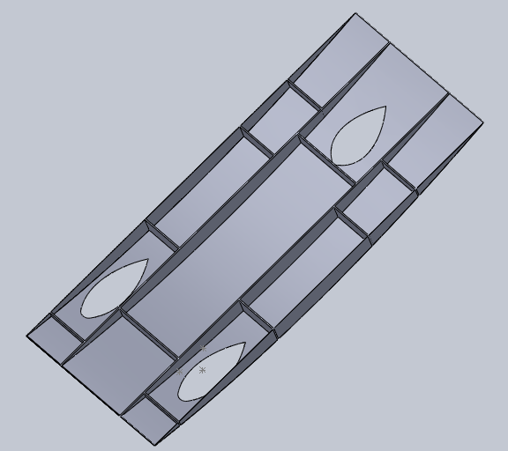
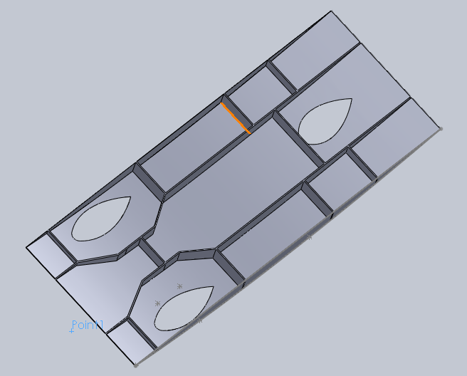
Design Update
Previous Proposed
Modification
  Suspension
  Battery Placement

Slide 7

Update
Carbon Fiber
  Purchased
    50 yards of 3K fabric
    $15/yard
  Donated
    100 yards 12K fabric
    Free ($5445.00)
MDF Mold Board
  Begin mold making process
Risks
  Mold
  Delivery of parts
  Schedule
Special Thanks to:
Ms. Anne Perkovich

Slide 8
Suspension Progress

Slide 9
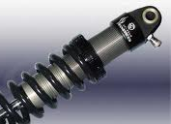
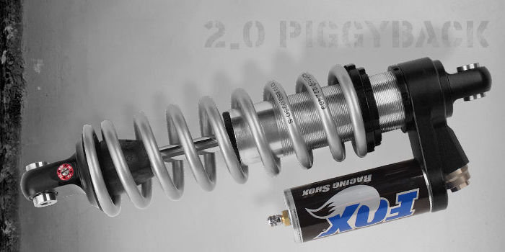
Hooke’s Law
Hooke’s Law
  F = -k*x
  => k = F/x
  Estimated weight of 520 lb. and 2 in. displacement
  Front suspension
    k = 65 lb/in for each spring
  Rear suspension
    k = 130 lb/in

Slide 10
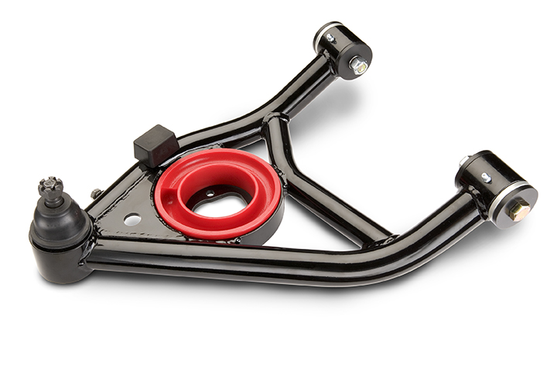
Control Arms
Optimum design
  Prevents big camber change
    Long control arms
  Reduce stress on arms
    Horizontal and vertical clearance distance between frame joints

Slide 11
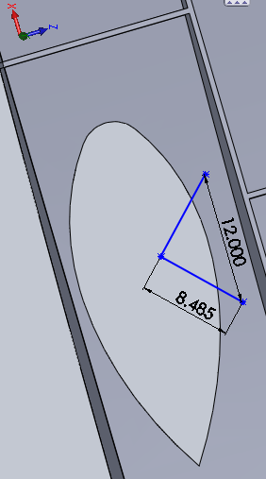
Current Design
Short clearance horizontally between frame joints
  12” between frame joints
Short control arms
  8.49” long
  10” from wheel center to frame joint horizontal reference
  Produce 5.5° of camber angle

Slide 12
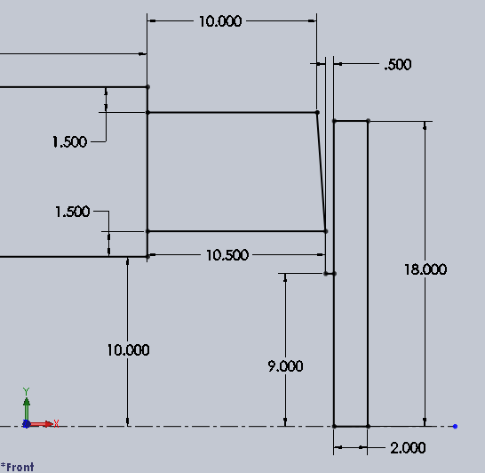
Current Design
Frontal view of front driver side suspension
Dimensions in inches

Slide 13
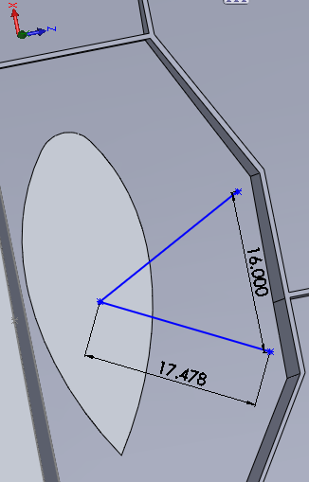
New Proposed Design
Longer clearance horizontally between frame joints
  16” between frame joints
Longer control arms
  17.48” long
  15.5” from wheel center to frame joint horizontal reference
  Produce 3.7° of camber angle
Increase rib height

Slide 14
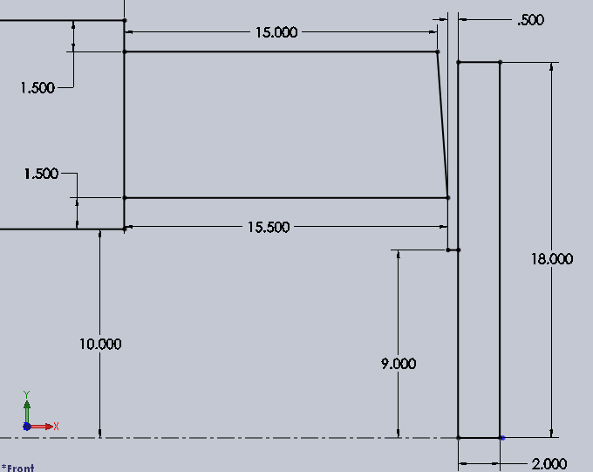
New Proposed Design
Frontal view of front driver side suspension
Dimensions in inches

Slide 15
Technical Risk

Slide 16
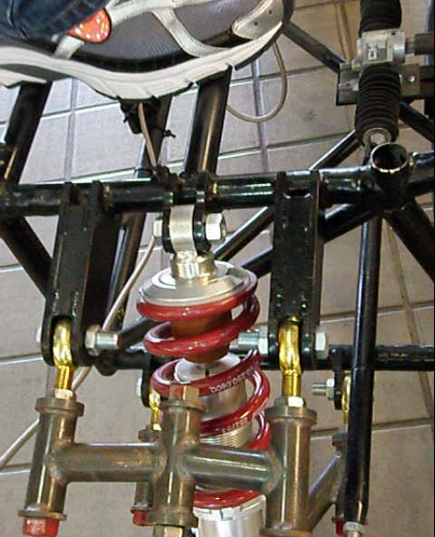
Wrong Spring Selection
Probability
  Low
Consequences
  Minor
  Too stiff or soft suspension
Strategy
  Revise suspension calculations
  Repeat simulations

Slide 17
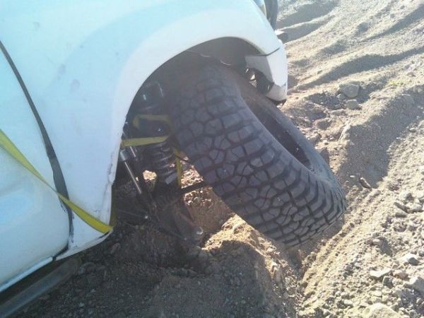
Control Arm Stress Failure
Probability
  Low
Consequence
  Catastrophic
  Undrivable car
  Loss of control
  Possible crash and driver injury
Strategy
  Research material properties
  Perform a thorough Finite Element Analysis (FEA)

Slide 18
Braking System

Slide 19
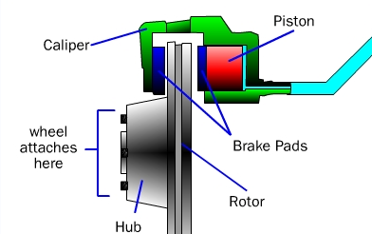
Disc Brake System
Hydraulic brake fluid is pressurized by application of brake pedal
Pressurized fluid push piston to apply friction on rotor

Slide 20
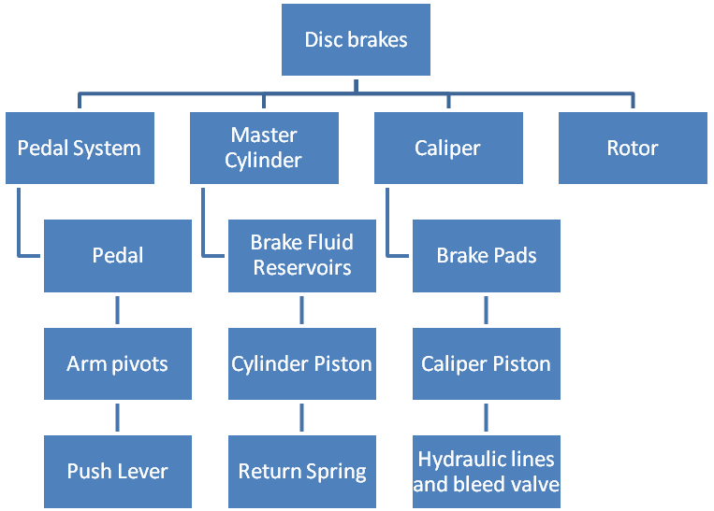
Disc Brake Components

Slide 21
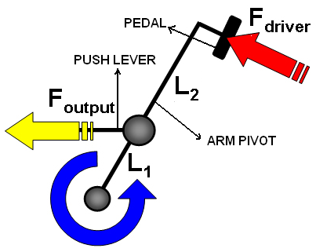

Pedal System
Pedal System is the input source of the brake system
Brake pedal output force can be calculated with:
Fbp = 293.3 lbf

Slide 22
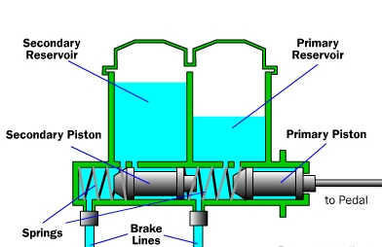

Master Cylinder
Translates force from brake pedal to hydraulic fluid pressure
Hydraulic pressure can be calculated using:

Slide 23
Master Cylinder

Slide 24
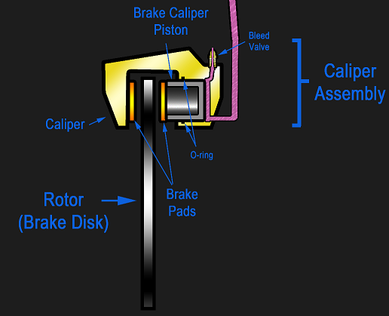



Brake Caliper
Hydraulic pressure from master cylinder is transmitted to caliper
Force from caliper is found using:
Clamping force from caliper is calculated using:

Slide 25
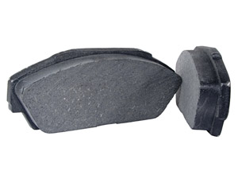

Brake Pads
Frictional force is related to clamp force by:

Slide 26
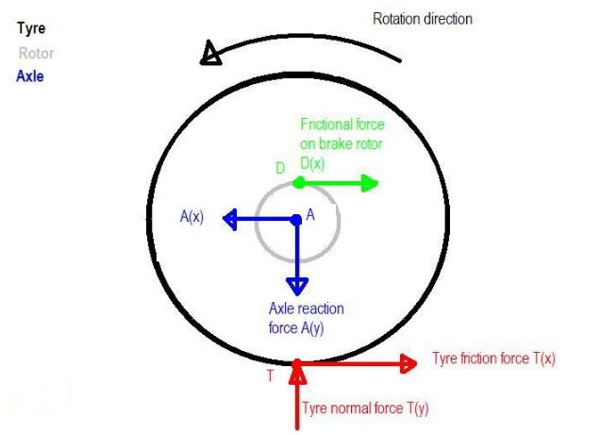



Brake rotor
Torque is related to brake pad frictional force by:
  Reff is effective radius of rotor
Torque is constant in entire rotating assembly
Force reacted to ground is found by:
Vehicle deceleration can be found using Newton’s second law

Slide 27

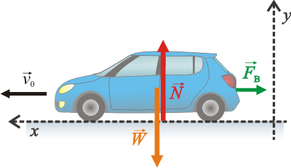
Minimum Required Brake Force
According to ASC regulations, car must have deceleration of at least 15.5 ft/s^2
Newton’s second law allows us to calculate minimum brake force
Using estimated weight of 520 lb’s
  Minimum brake force is equal to 250 lbf

Slide 28


Technical Risk

Slide 29
Steering system

Slide 30
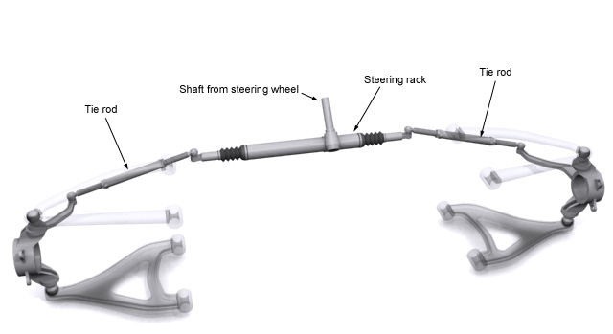
Steering
Rack and pinion steering will be salvaged from previous year’s car
New gear box is to be chosen
  Awaiting finalized weight and body dimensions

Slide 31
Risk Assessment
Tie rods are not long enough to reach suspension
Rack will not fit into the car
Not enough space in wheel wells to reach ideal turning angle

Slide 32
Power Generation System

Slide 33
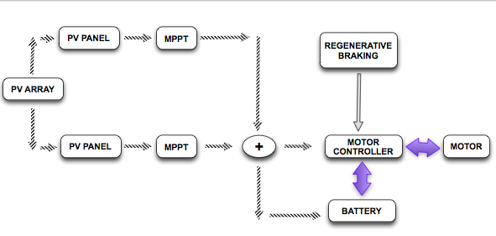
Power Generation

Slide 34
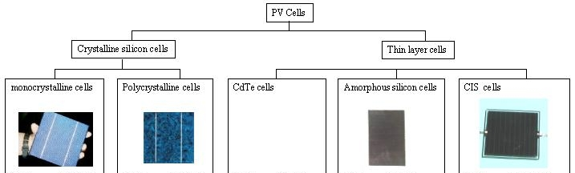
Different solar cells

Slide 35
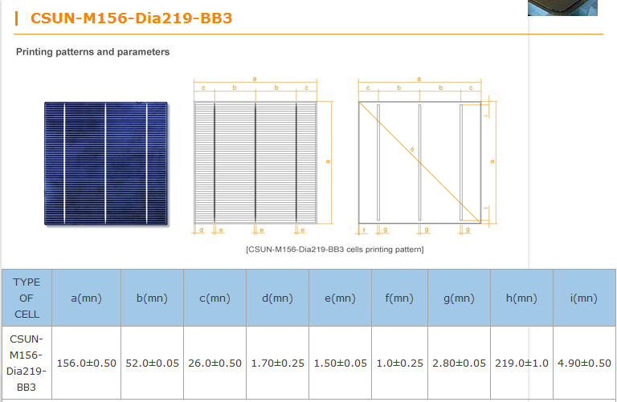
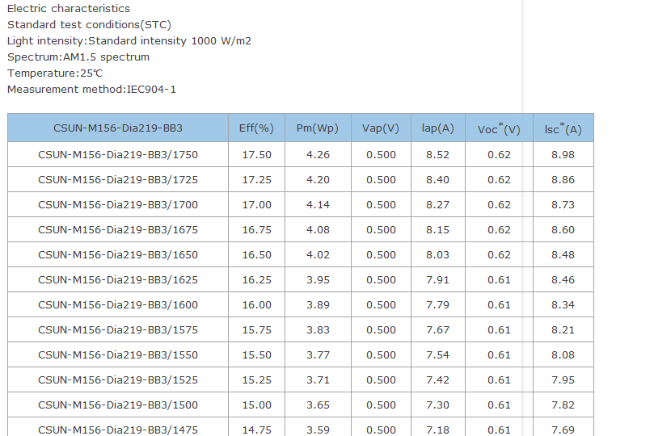
Models

Slide 36
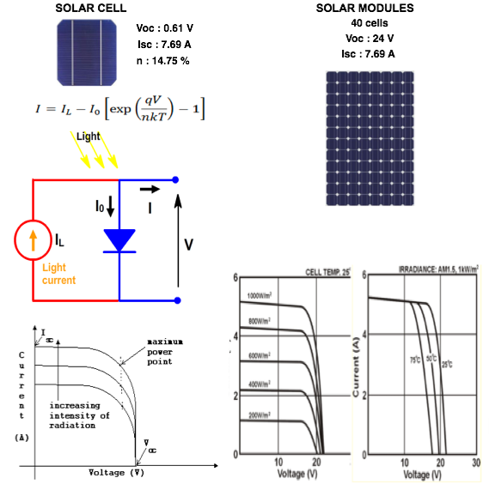
Solar power

Slide 37
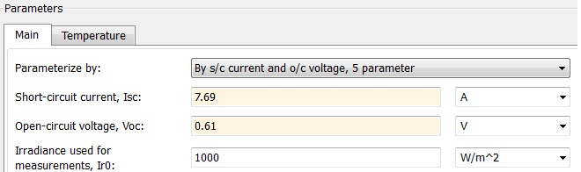
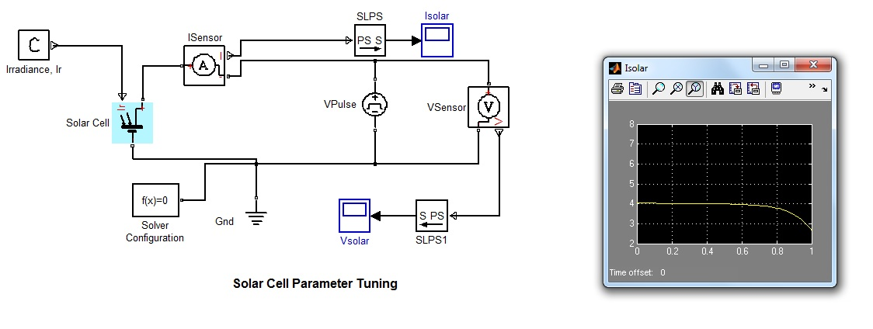
Solar Cell

Slide 38
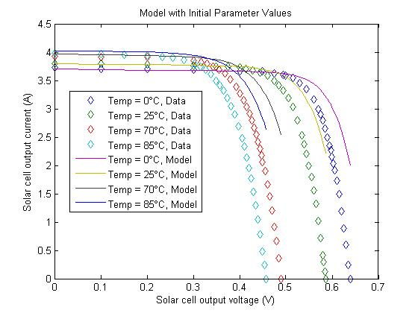
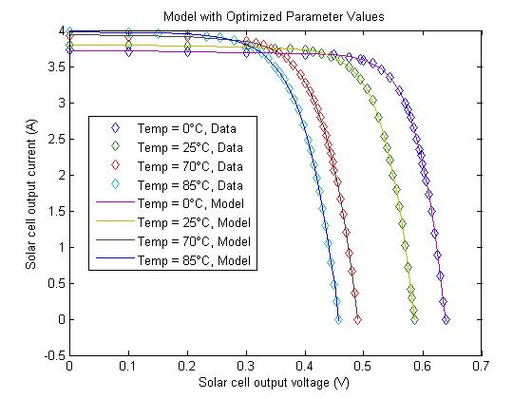
Solar cell: Voc (V) versus Isc (A)

Slide 39
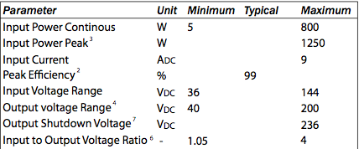
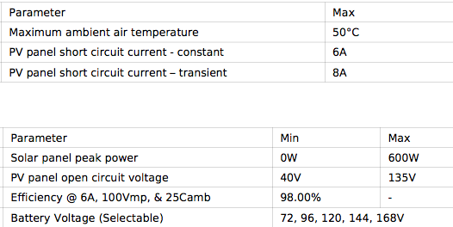
MPPT
DRIVETEK RACE
AERL 600 B

Slide 40
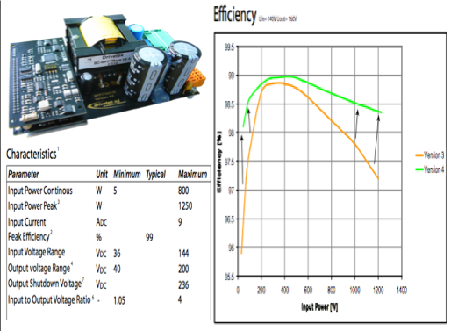
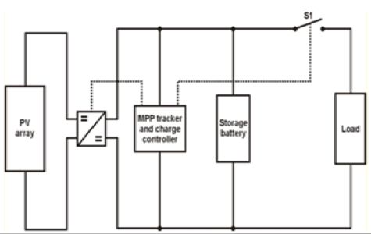
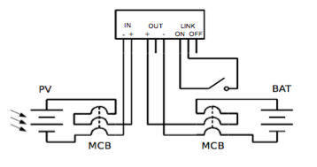
MPPT

Slide 41
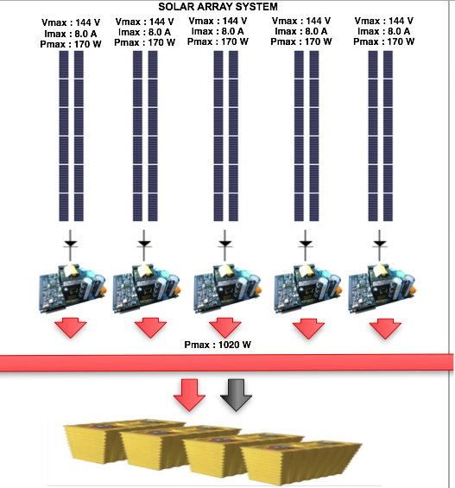
Solar array

Slide 42
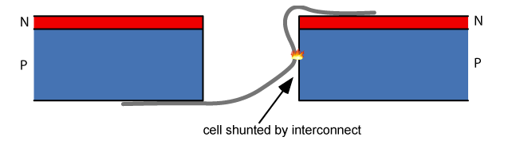
Risks - Solar
Risk | Module glass breakage
Probability | Moderate
Consequences | Severe
Strategy | Due to thermal stress, handling, wind, hail, or vandalism
Risk | Short-circuited cells
Probability | Moderate
Consequences | Moderate
Strategy | ensure proper cell interconnections

Slide 43
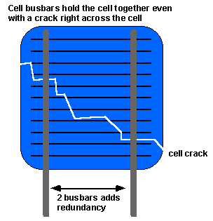
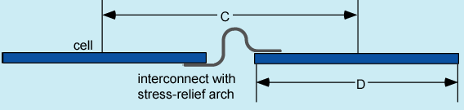
Risks - Solar
Risk | Open-circuited cells
Probability | Moderate
Consequences | Moderate
Strategy | Use double-interconnects to protect against fatigue failure

Slide 44
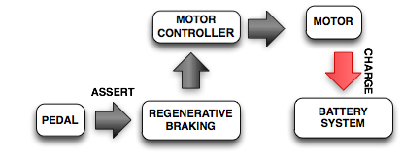
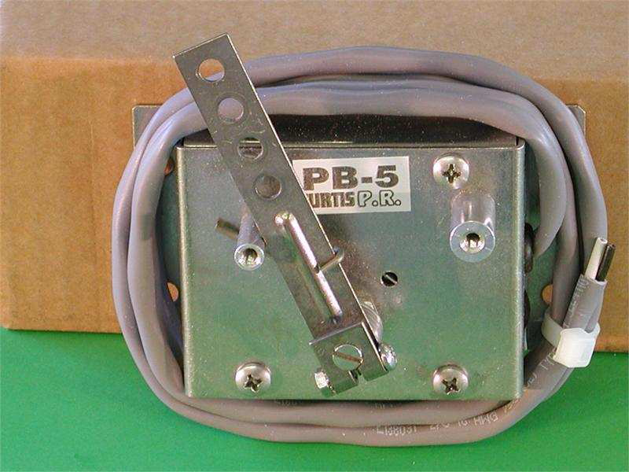
Regenerative Braking
“Handle-type” | Micro-controller based | Brake controller
Easy to implement | Programming required | Intense programming required
Independent to frictional brake | Regenerative brake applied for “soft” braking only | Coupled mechanical and regenerative brake

Slide 45
Control System

Slide 46
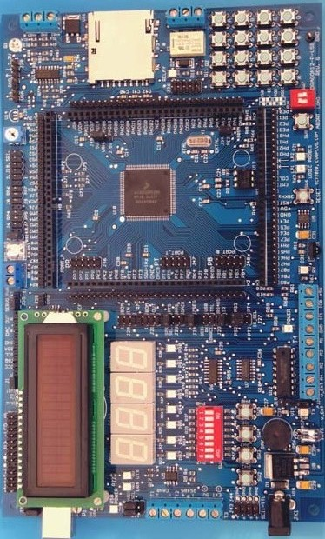
Master Control Unit
Board has been purchased
Code to control LCD display is complete
Code to transmit data to motor controller in progress

Slide 47
Motor Controller
240 bytes of configuration and status data
9600 baud serial communication
Status and drive state info will be gathered periodically
Auto fault detection
Voltage and current protection

Slide 48
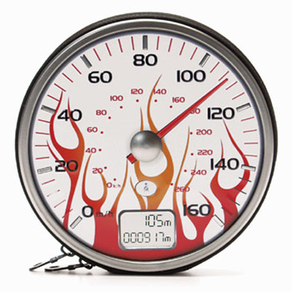
Speedometer
Currently the speedometer is not functioning correctly
Problem with signal sent from the motor controller
Proposed solution is to periodically gather speed information from the motor controller

Slide 49
Relays
SW-190 Series
High voltage, DC rated
Normally open contacts
12V coils
120V, 200A

Slide 50
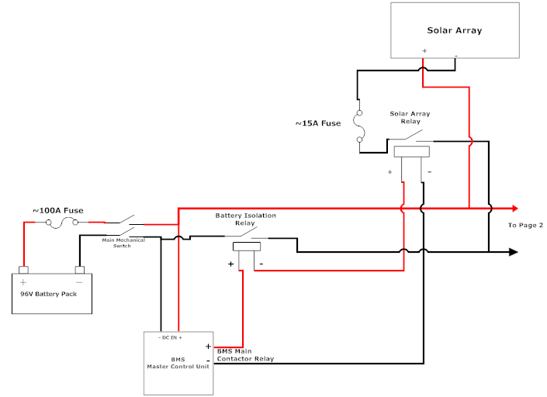
Power Control Design

Slide 51
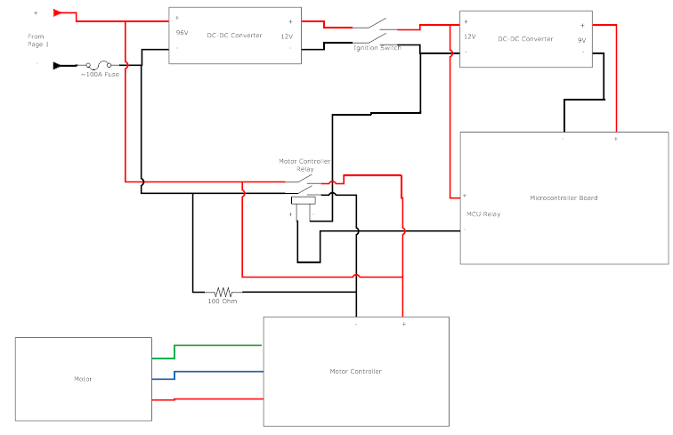
Power Control Design

Slide 52
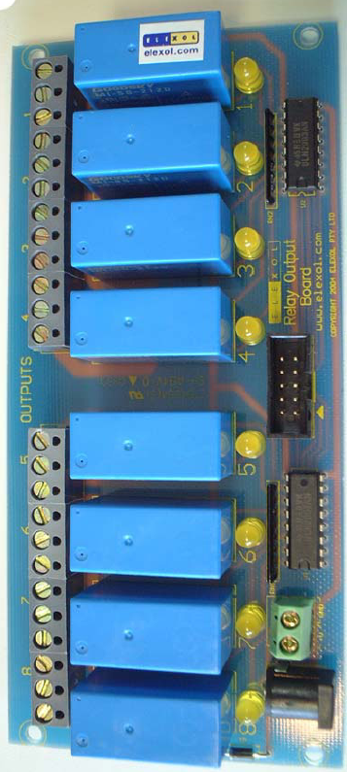
Lights
Relays are needed to power lights
MCU will control the relays
LED lights will be used

Slide 53
Control System Risks
Risk | MCU code does not function properly
Probability | High
Consequences | Moderate to Severe
Strategy | Simulate code first to verify functionality Use test circuits to verify functionality before attaching to critical systems
Risk | Dashboard area too small
Probability | Low
Consequences | Moderate
Strategy | Depending on the component, it can be relocated to another part of the car in view/reach of the driver

Slide 54
Management System

Slide 55
Overview
Management System
Stored Energy
Propulsion
Batteries
Protection Circuit
Wall Charging
State of Charge
Motor Controller
Motor

Slide 56
Battery Update
New battery box must be designed
  Contain 30 batteries
  Easy to remove
  Quick disconnects
Exploring different design options
  Front of car
  Rear of car
Dimension | Size
Length | 4 ¼"
Width | 1 ¾"
Height | 6 ½"

Slide 57
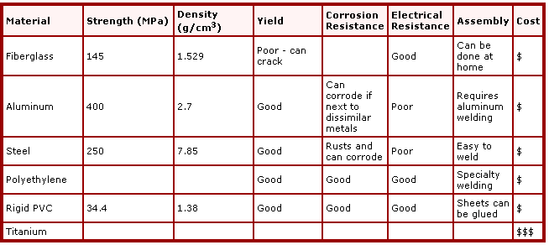
Battery Box
Low weight
Durable
Weather resistant
Insulated
Low cost

Slide 58
Battery Risks
Protection Type | Restraining Value
Over Voltage | 4.25 V
Under Voltage | 2.5 V
Over Current | 120 A
Over Temperature | 75 °C
Operating in unsafe conditions
Incorrect wire gauges
Lack of proper insulation
Any incidental contact with driver

Slide 59
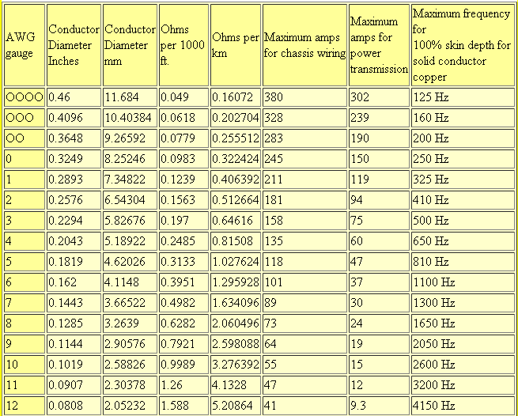
Wire Gauges

Slide 60
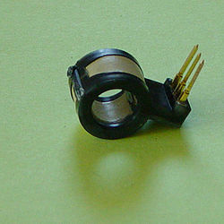
Hall Effect Sensor
Advantages
Disadvantages
Immune to dust and dirt, allowing for more accurate measurements
No direct contact with the wire
Creates a voltage potential proportional to the sensed current
Results possibly diminished by nearby wires also generating magnetic fields
Very small potential on the order of mV

Slide 61
Budget & Schedule

Slide 62



Budget
Item | Cost
Carbon Fiber Composite | $ 750
Resin | $ 500
Solar Cell | $ 15,396
Power Tracker (MPPT) | $ 800
Camera & Display | $ 150
Misc Electrical | $ 500
Microcontroller | $ 180
Aluminum Stock | $ 108
Suspension Parts | $ 315
Braking System | $ 400
Steering System | $ 434
Misc Mechanical | $ 150
Driver Related Equipment | $ 435
Competition Fees | $ 7,000
Travel Expenses | $ 10,000
Total | $37,118
Budget estimate to date: $37,118
Budget from University: $5,000
Deficit: $32,118
Donations
  Hexcel
  SolidWorks
  MSC ADAMS

Slide 63
Major Milestones
System level design review November 15, 2010
Assemble lower body December 16, 2010
Assemble upper body January 21, 2011
Detailed design review and test plan January 27, 2011
Configure lower body February 21, 2011
Install solar arrays February 23, 2011
Total body configuration March 15, 2011
Final testing March 29, 2011

Slide 64
Questions???

Slide 65
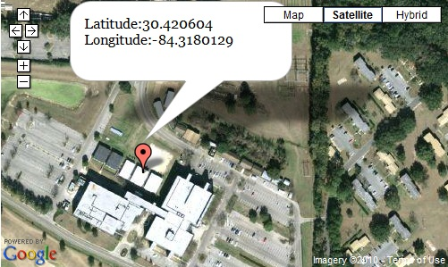


Orientation
Tilt panel in an angle to capture most sun
Positive latitude = South orientation

Slide 66

Cockpit Dimension

